Slide 1
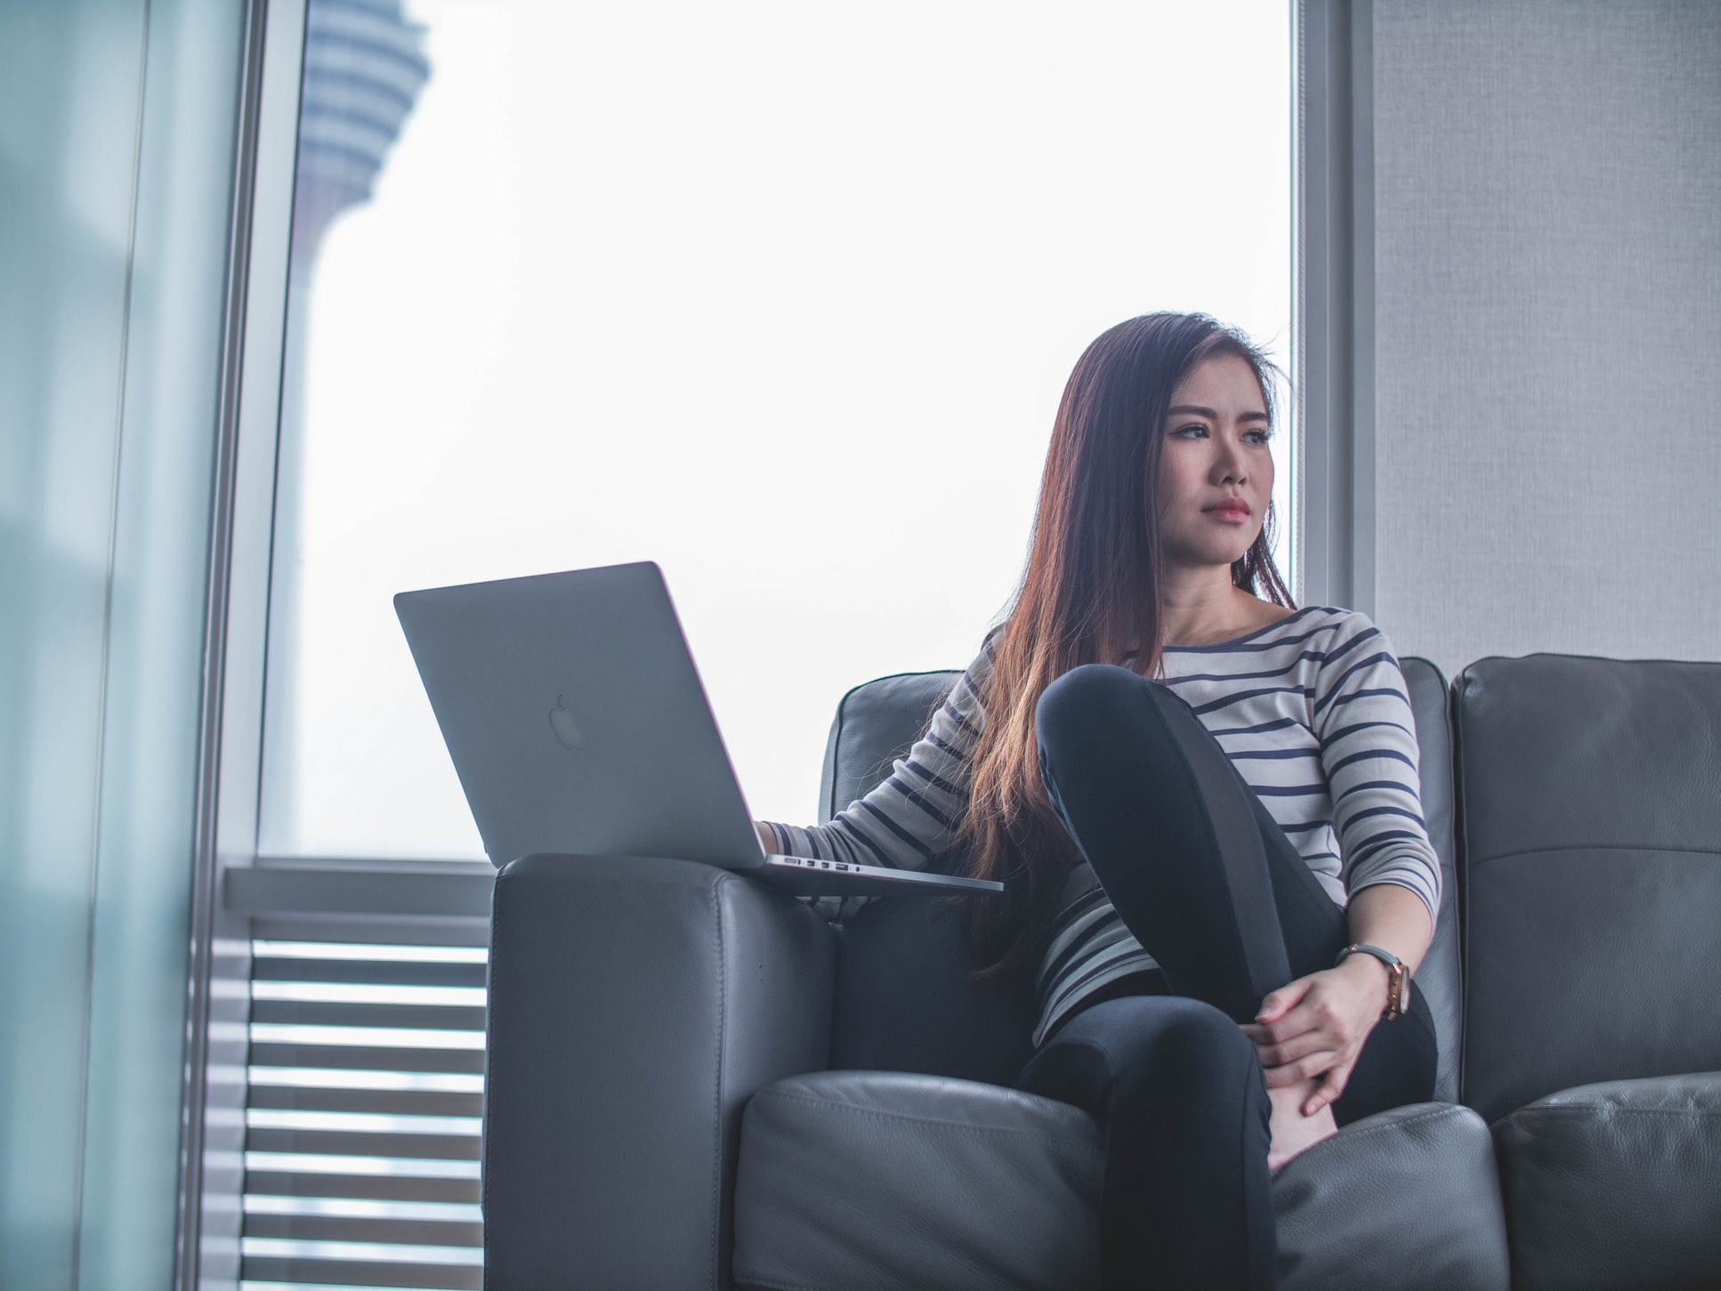
Jessy Lim
“I live in Cheras working in KL city center area. I want to dress well when meeting my client but I don’t want to spend more than RM 150 per dress.”
Age | 27
Job | Sales & Marketing Executive
Education | Bachelor’s Degree in Marketing
Location | Kuala Lumpur
Family | Single
Archetype | Straightforward Marketing Professional
Product Adoption Group | Early Majority
GOALS
DECISION MAKING
Look well when meeting clients
Finding work dresses that fits her well at reasonable price
Wants to build good first impression with all of her clients
Prefers to gather her information online
Believes in product referrals of online influencers
FEARS, CHALLENGES AND PROBLEMS
SOLUTION
Always busy driving around meeting client everywhere in KL
Doesn't want to do alterations once she purchases the dress
Promote to her a trendy work dress @ below RM150 . Also give her example on how to put a look together so she can picture the item with dresses or shoes she already has

